Slide 1
Civic Education and Equal Suffrage in the Digital Age
Gio Kobakhidze
IFES Ukraine Deputy Country Director
IFES Technical Lead on Civic Education
Sinaia, Romania
Mary 3, 2018

Slide 2
Civic education for democratic citizenship;
The pursuit and defense of equality, electoral or otherwise; and,
The survival of our democracies in the digital age.

Slide 3
“Democracy is…
under attack
in retreat
in decline
in crisis
dying…”

Slide 4
Current State of Democracy
Rise of Populism and the Politics of Exclusion
New Technology and Social Media +
New Reality

Slide 5
If citizens ignore longstanding democratic principles and norms, identity politics can and will fill this vacuum, and today, more than ever before, technology can be used with surgical precision to achieve this end.

Slide 6
Where, when and how do we learn to play an active part in democratic life, and in defending democratic values?

Slide 7
“…to empower [learners] to exercise and defend their democratic rights and responsibilities in society, to value diversity and to play an active part in democratic life, with a view to the promotion and protection of democracy and the rule of law.”

Slide 8
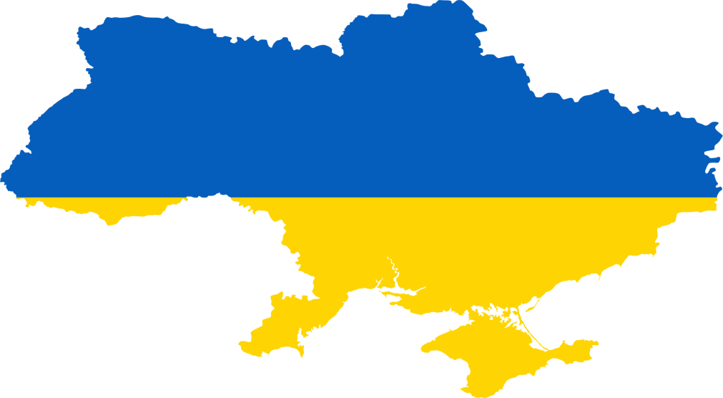
“Democracy and Citizenship” 2011
Snapshot:
IFES SEED Methodology
“Democracy: from Theory to Practice”
2018

Slide 9
Three-pronged learning approach:
the course curriculum and text materials
interactive civic education teaching methodologies
student action projects
Knowledge
Skills
Democratic attitudes and values

Slide 11
Three-pronged learning approach:
the course curriculum and text materials
interactive civic education teaching methodologies
student action projects
Knowledge
Skills
Democratic attitudes and values

Slide 12
Thank you
This presentation is based on research made possible by the United States Agency for International Development (USAID), Global Affairs Canada and UK aid. The opinions expressed herein are those of the author and do not necessarily reflect the views of USAID, the United States Government, Global Affairs Canada, the Government of Canada, UK aid or the UK government.

